Slide 1
Astro-sage sales analysis
Amaan Saiyyad

Slide 2
CONTENTS
Introduction
Methodology
Key Metrics
Dashboard
Strategic Initiatives
Conclusion & Recommendations

Slide 3
INTRODUCTION
Astro-sage is a website and app that provides astrology services, including horoscope matching, birth chart generation, and AI astrologers.
Astro-sage is used by Hindus to make decisions about marriage, opening a business, or moving to a new
Astro-sage is used by many astrologers to create birth charts and match horoscopes.

Slide 4
Methodology
Data Cleaning -: Used spreadsheets functions like trim and Removing duplicates for data cleaning.
Data Enrichment -: Added new variables using Date functions for better analysis.
Customer Segmentation -: Used Sorting and Filtering to classify customers based on consultation type and also used slicer.
Used Pivot tables to analyze the performance of consultants over different category type and ratings received on basis of consultations from users.
Visualization -: Created interactive dashboard using different charts for detailed view of dataset.

Slide 5
Key metrics
1) KPI’s
Total Calls :- 8508 and Total Chats :- 19514 → Reflects the overall call and Chat volume handled by the center, indicating high customer engagement
Cost per Call - ₹9.14 → Shows operational efficiency by measuring average cost per customer interaction.
Average Daily Calls :- 250 → Highlights number of calls handled per day within the selected time range.
Average Rating – 2.9 → Represents customer satisfaction and service quality across all calls.
Repeat Callers – 56% → The percentage of customers who have contacted more than once.

Slide 6
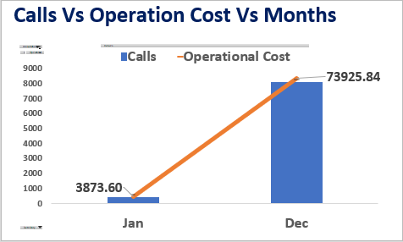
Key metrics
2) Calls vs Operational Cost by Month
This chart compares the total call volume (blue bars) with the operational cost (orange line) across months.
January shows fewer calls and lower costs.
December shows a sharp rise in both call volume and costs, reflecting increased demand and higher resource utilization.
The relationship highlights how operational cost scales with call activity.

Slide 7
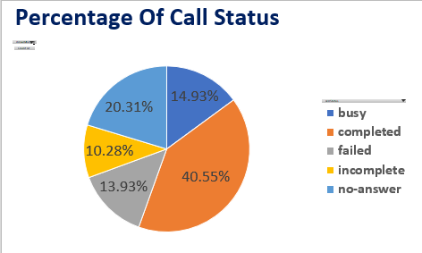
Key metrics
3)Percentage Of Call Status
This chart compares the calls by their completion status — Completed, Failed, Busy, No Answer, Incomplete.
A high percentage of Completed Calls indicates effective call handling.
A notable portion of Busy/Failed calls signals operational inefficiencies.
It helps monitor call handling efficiency and service reliability.

Slide 8
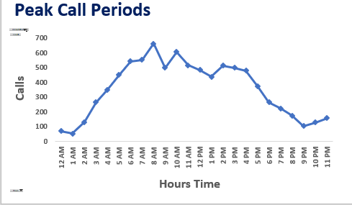
Key metrics
4) Peak Call Periods
This chart shows the distribution of calls across different hours of the day.
The highest call volumes occur around 8 AM and 10 AM, indicating peak customer demand.
Lower call activity is observed during late-night and early-morning hours.

Slide 9
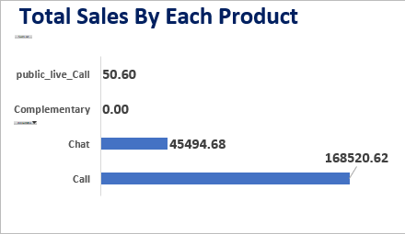
Key metrics
5) Total Sales by Product
This chart shows the distribution of sales across different consultation types.
Call services generated the highest revenue at ₹168,520, making them the primary driver of income.
Chat consultations contributed ₹45,495, indicating secondary demand.
Public live calls contributed marginally (₹51), showing minimal uptake.
Complementary Has Zero Contribution

Slide 10
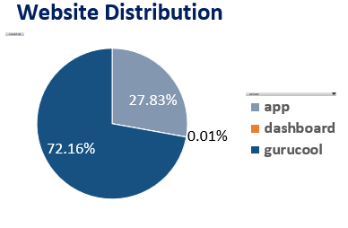
Key metrics
6) Website Distribution
This chart highlights The percentage of calls/chats handled through different platforms — App, Dashboard, Gurucool.
The majority of users access services through the Gurucool platform (72%), followed by the App (28%) and Dashboard (0.1%)
This Chart guides digital investment by showing where the majority of users are active.

Slide 11
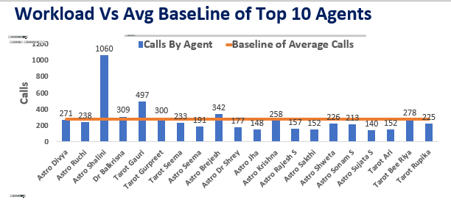
Key metrics
7) Workload Vs Avg Baseline of Top 10 Agents
This chart shows A bar + line combo chart comparing each astrologer’s total handled calls against the team’s average baseline of 278 Calls
Compares each astrologer’s call volume against the team’s average. It helps identify workload balance and ensures no agent is overburdened.

Slide 12
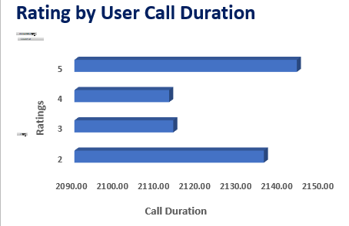
Key metrics
8)Rating By User Call Duration
This chart shows Relationship between call duration and customer satisfaction rating .
Ratings are generally low for moderate call durations, showing that moderate calls need more attention on customer satisfaction by the organization.
Extremely long or short calls yield more satisfaction — useful insight for training astrologers on ideal consultation length.

Slide 13
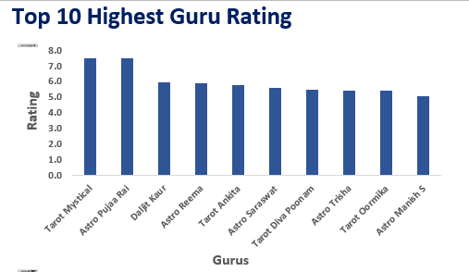
Key metrics
9) Top 10 Highest Guru Rating
This chart compares the average customer ratings of top 10 High performing agents (gurus).
Tarot Mystical and Astro Pujaa Rai received the highest ratings (7.5), reflecting strong customer satisfaction.

Slide 14
Key metrics
10) Top 10 Low Guru Rating
This chart compares the average customer ratings of top 10 Low performing agents (gurus).
Tarot Rittika and Astro K Ojha received the Lowest ratings of 0 and 0.1, reflecting weakest customer satisfaction.

Slide 15
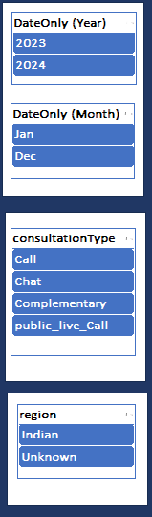
Key metrics
11) Dashboard Slicers (Filters)
The slicers make the dashboard interactive and allow management to drill down into specific segments of data:
Year & Month → Analyze performance across different time periods.
Consultation Type → Compare call, chat, complimentary, and live consultations.
Region → Differentiate performance between Indian and Unknown regions.

Slide 16
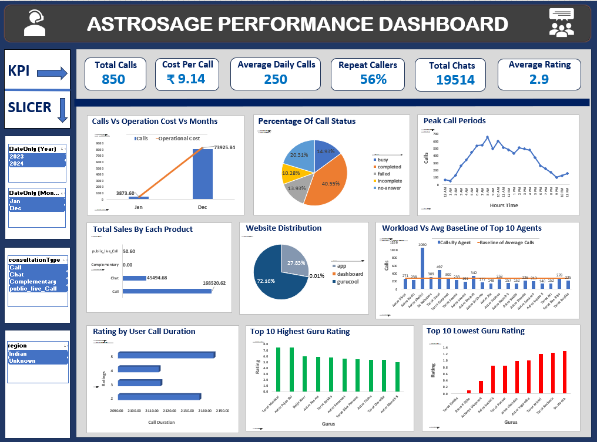

Slide 17
Strategic Initiatives
Astro-Sage has grown into a busy call center, and the data shows both opportunities and challenges. One of the key focus areas should be balancing agent workload. At present, a few agents are handling much higher call volumes than others, which risks burnout and inconsistent service quality. By redistributing calls and offering targeted training, efficiency can be improved.
Another important step is to raise customer satisfaction. The average ratings are moderate, and long call durations often correlate with lower feedback. Equipping agents with better communication skills, empathy training, and tools for faster issue resolution will directly boost ratings.
At the same time, cost per call is rising, which highlights the need for stronger cost controls. Optimizing resource allocation, reducing idle time, and making use of automation for repetitive queries can reduce expenses without compromising service.
Astro-Sage should also strengthen its product mix. Currently, most of the engagement comes from traditional calls, while chat and live calls remain underutilized. Encouraging customers to shift to these alternative channels can lower costs and improve scalability.
Lastly, the analysis clearly shows peak demand hours where call volumes spike. Having more agents available during these periods will reduce waiting times and improve the overall customer experience.

Slide 18
Conclusion & Recommendations
In conclusion, the dashboard reveals that Astro-Sage is handling a large and growing number of calls, but operational costs and customer satisfaction need close attention. While repeat callers form over 80% of the traffic a sign of loyalty it also suggests that many issues may not be fully resolved in the first interaction.
To make the best use of the ₹1 crore investment, Astro-Sage should focus on three priorities: improving service quality, controlling costs, and leveraging technology. By investing in training, predictive scheduling, and smarter use of multiple channels, the company can enhance both customer satisfaction and profitability.
This approach will not only improve day-to-day performance but also build a stronger foundation for long-term growth in a highly competitive market.

Slide 19
THANK YOU

